Slide 1
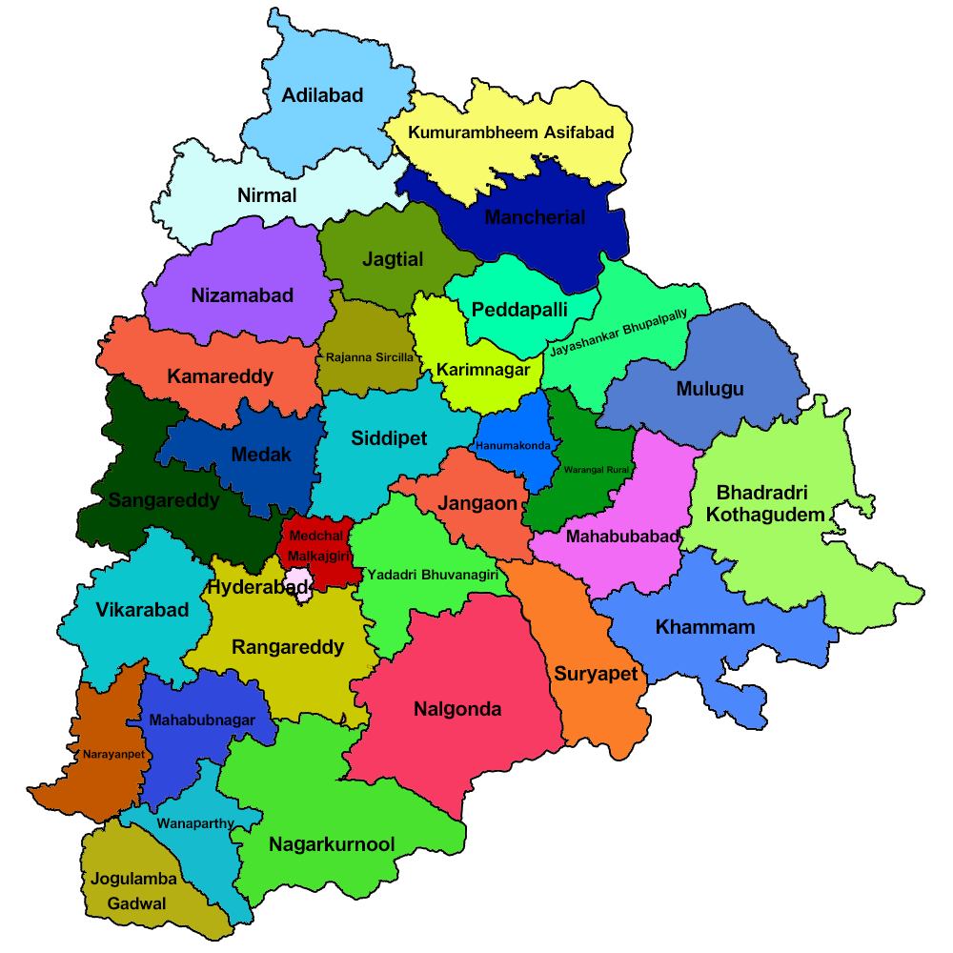
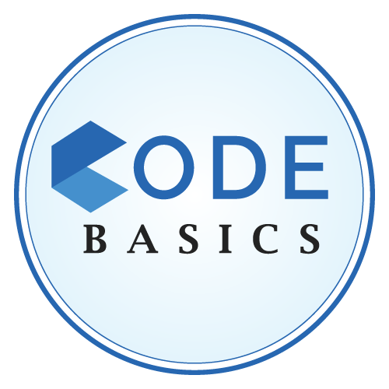
Telangana Tourism Analysis
Telangana, a state located in southern India, is known for its rich cultural heritage and history, which makes it a popular tourist destination.
I have performed my data analysis skills to uncover some insights for Telangana tourism. The dataset is taken from Open Data Telangana. (https://data.telangana.gov.in/).
Thanks to Mr. Kalvakuntla Taraka Rama Rao (IT minister of Telangana) for making this data set publicly available
A challenge by

Slide 2
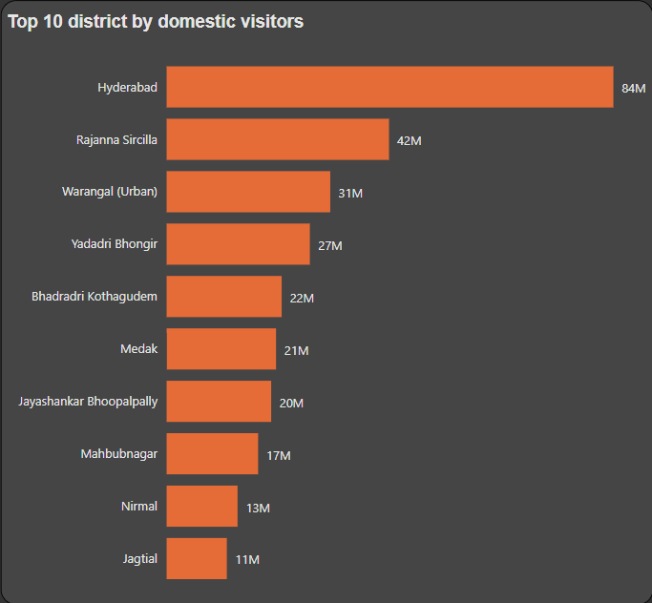
Top 10 districts with highest number of visitors overall (2016 - 2019)
﻿At 83.9 Million, Hyderabad had the highest Domestic visitors and was 642.26% higher than Jagtial, which had the lowest Domestic visitors at 11 Million in the top 10 list. At 83.9 Million, Hyderabad had the highest Domestic visitors and was 642.26% higher than Jagtial, which had the lowest Domestic visitors at 11 Million in the top 10 list.﻿
﻿Hyderabad accounted for 29.25% of Domestic visitors in the top 10 districts.﻿ ﻿

Slide 3
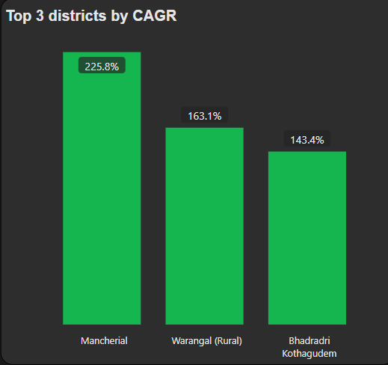
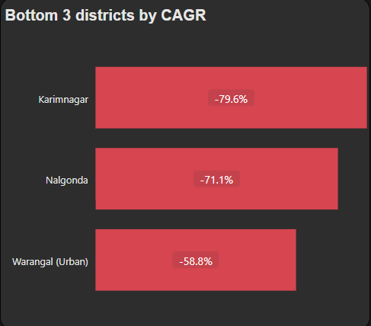
﻿
CAGR based insights
﻿Mancherial had the highest CAGR at 225.8%, followed by Warangal (Rural) at 163.1% and Bhadradri Kothagudem at 143.4%.﻿
﻿Warangal (Urban) had the lowest CAGR at -58.8%, followed by Nalgonda at -71.1% and Karimnagar at -79.6%.﻿

Slide 4
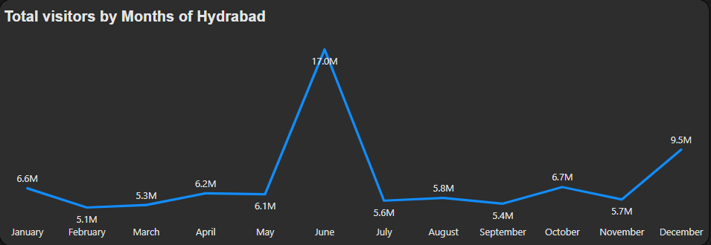
Peak and low season months for Hyderabad from 2016 to 2019
﻿At 17 million, June had the highest Total visitors and was 231.47% higher than February, which had the lowest Total visitors at 5.1 million.﻿ ﻿June accounted for 19.97% of Total visitors.﻿
January and December have seen the most visitors after June month, if Telangana government provide more events, better arrangements and facilities to visitors in these months. More attraction of visitors can be seen.

Slide 5
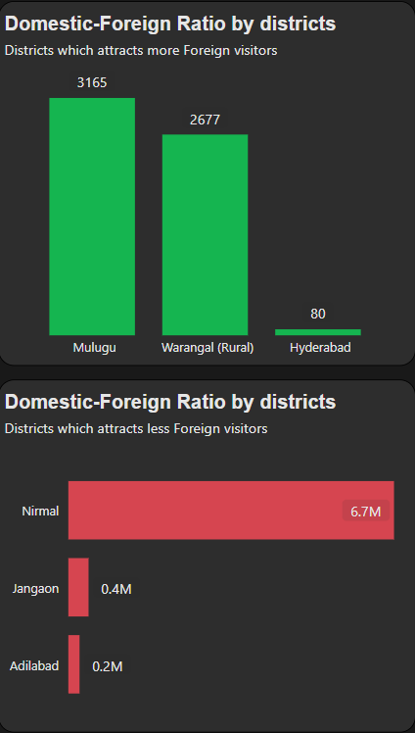
﻿
Domestic to Foreign ratio
Mulugu, Warangal (Rural) and Hyderabad are the districts which attracts more foreign visitors as compared to domestic visitors.
Nirmal, Jangaon and Adilabad are those districts which attracts less foreign visitors as compared to domestic visitors.
As foreign visitors bring more revenue to the state, government should replicate same facilities as in Hyderabad, Mulugu, Warangal (Rural) to the other districts.

Slide 6
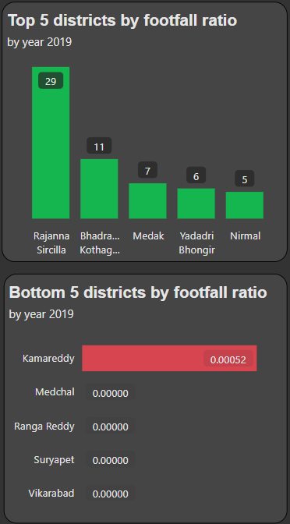
﻿
CAGR based insights
Population to tourist footfall ratio
Ratio: Total visitors / Total residential population in given year
Rajanna Sircilla, Bhadradri Khotagudem, Medak, Yadadri Bhongir, Nirmal these are the districts with high population to tourist footfall ratio.
Kamaredddy, Medchal, Ranga Reddy, Suryapet, Vikarabad these are the districts with lowest population to tourist ratio footfall ratio. 4 districts have 0 ratio this is because there is zero visitors or very negligible number of visitors.

Slide 7
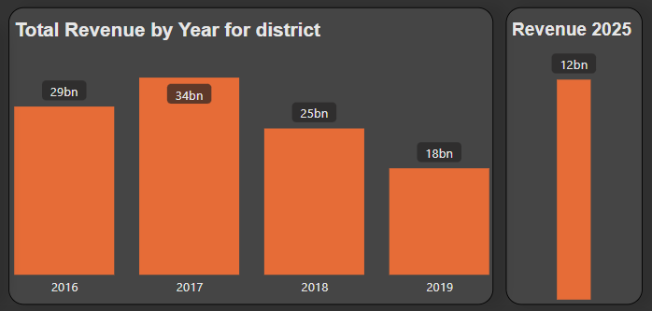
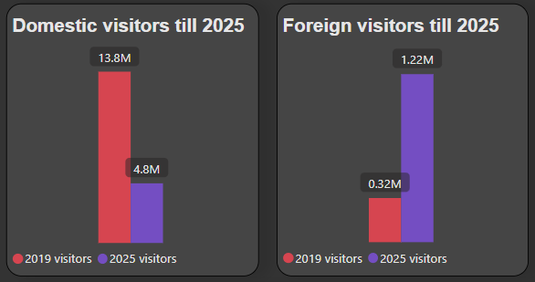
﻿
CAGR based insights
Hyderabad insights
Projected revenue for Hyderabad in 2025 is 12 billion Calculated based on: Avg revenue from domestic visitor: 1200 Rs Avg revenue from foreign visitor: 5200 Rs
Projected domestic visitors for Hyderabad: 4.8 million
Projected foreign visitors for Hyderabad: 1.22 million
CAGR of Hyderabad is -15% which means there is decline in the trend of visitors. As seen in the chart Domestic visitors of Hyderabad is declining but Foreign visitors are increasing.

Slide 8
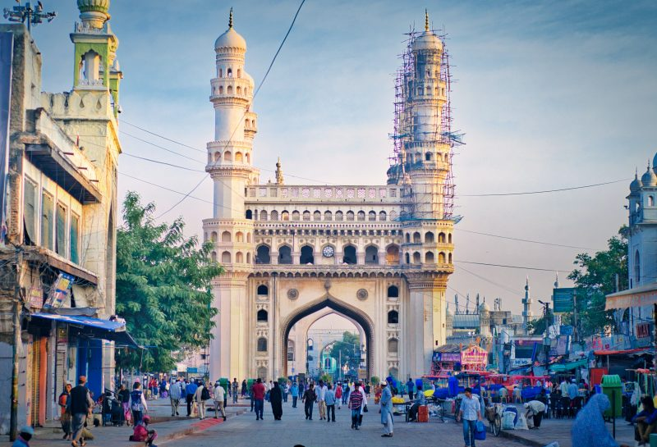
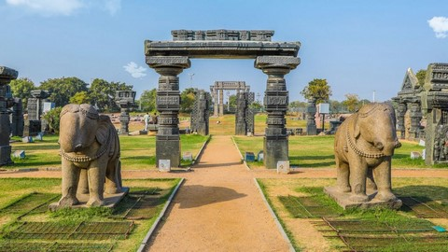
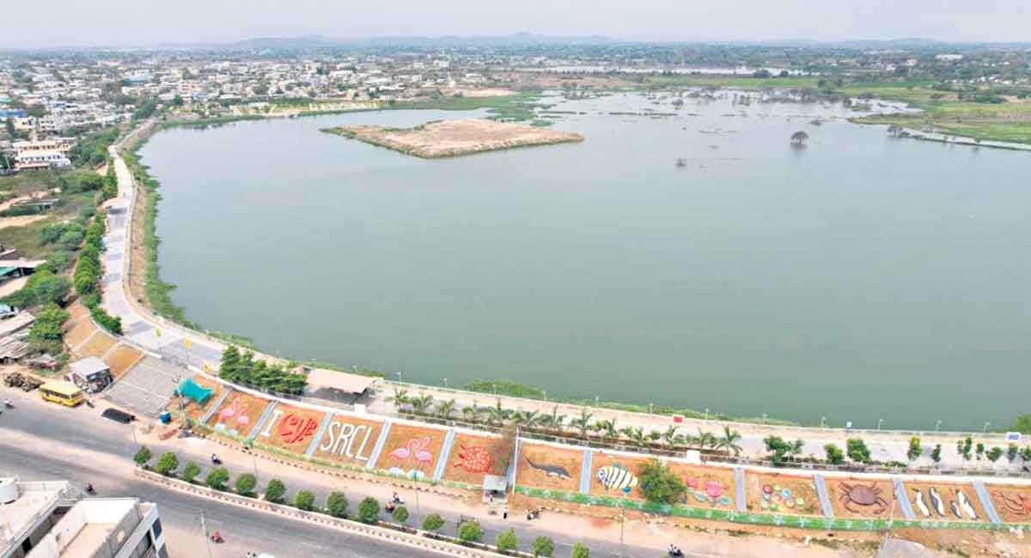
﻿
CAGR based insights
Potential districts of Telangana for tourism
Telangana has several districts that have the potential for tourism growth. Some of the districts with high potential for tourism growth are:
Hyderabad - The state capital has a rich cultural heritage, significant landmarks, and vibrant street life, making it a popular destination for both domestic and international tourists. (capital of Telangana with Highest number of visitors among all districts good attracts high number of foreigners)
Warangal - Known for its historic monuments such as the Thousand Pillar Temple, Warangal Fort, and Ramappa Temple, Warangal is an important cultural and heritage destination. (Good CAGR and Domestic to foreign ratio) Rajanna Sircilla - The district has several temples such as Vemulawada Temple, Sri Vidya Saraswathi Shani Temple, and Sri Anantha Padmanabha Swamy Temple, which attracts thousands of devotees every year. (Highest footfall ratio 29 which means the number of visitors are so much high as compared to actual population)

Slide 9
﻿
To grow tourism government can take following measures
Developing infrastructure such as roads, airports, and accommodation facilities to make these destinations more accessible and attractive to tourists.
Promoting local culture and heritage through festivals, events, and cultural shows to attract tourists who are interested in learning about the local way of life.
Creating tourism circuits that link different destinations within a district or region to encourage longer stays and repeat visits.
Providing incentives and support to local entrepreneurs and small businesses to develop and promote tourism products and services.
Investing in marketing and promotion campaigns to raise awareness of these destinations and attract more domestic and international tourists.
By taking these and other measures, the government can support the growth of tourism in Telangana and help to generate economic and social benefits for local communities.

Slide 10
﻿
Events should be organize by government to boost tourism
Cultural Festivals - The state has a rich cultural heritage, and organizing cultural festivals like Bonalu, Bathukamma, and Deccan Festival can showcase the vibrant and diverse cultural traditions of Telangana.
Religious Festivals - Telangana has several popular pilgrimage sites, and organizing festivals like the Vemulawada Sammakka Saralamma Jatara, Medaram Jatara, and Yadagirigutta Brahmotsavams can attract thousands of devotees from across the country.
Sports Events - Organizing sporting events like cricket, badminton, and tennis tournaments can attract sports enthusiasts and promote sports tourism in the state.
Adventure Tourism - Organizing events like trekking, rock climbing, and camping can attract adventure enthusiasts to the state.
Food Festivals - Telangana is known for its delicious cuisine, and organizing food festivals can attract food lovers from across the country.
Music Festivals - Organizing music festivals featuring local artists and musicians can promote the state's music traditions and attract music lovers to Telangana.
By organizing such events and festivals, the Telangana government can promote tourism in the state and attract more domestic and international visitors. These events can also provide a boost to the local economy by generating employment and increasing the demand for local products and services.

Slide 11
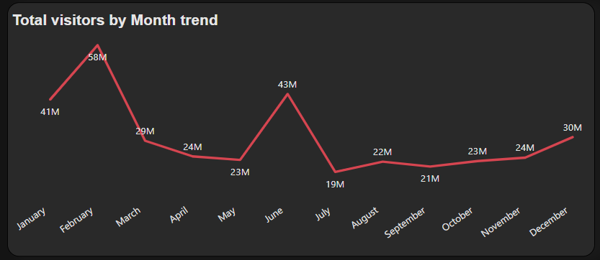
In which months and which districts events should be organized?
As we can see from Jan to Mar and May to July there is a peak in number of visitors Hence this period is best to organize events and festivals.
Hyderabad, Mancherial, Warangal, Bhadradiri kothagudem, Rajanna Sircilla are some rapidly growing districts. If events and festivals are organized in these states it will boom the tourists.

Slide 12
﻿
How can Hyderabad emulate Dubai business model and enhance tourism?
Dubai has become a successful business hub and a popular destination for business tourism due to several factors, such as its strategic location, world-class infrastructure, ease of doing business, and proactive government policies. To emulate the Dubai model, Hyderabad can take the following steps:
Developing world-class infrastructure - Hyderabad can invest in developing world-class infrastructure such as airports, transportation systems, communication networks, and other essential facilities to create a conducive environment for businesses.
Ease of doing business - Hyderabad can create a business-friendly environment by simplifying regulatory procedures, reducing bureaucratic red tape, and improving the ease of doing business index.
Proactive government policies - Hyderabad can encourage entrepreneurship by introducing business-friendly policies and providing incentives to businesses to set up their operations in the city.
Promoting innovation and technology - Hyderabad can position itself as a hub for innovation and technology by creating an ecosystem that supports research and development and encourages startups.
Networking and Collaboration - Hyderabad can establish networking and collaboration opportunities between businesses, government, and research institutions to create a synergistic environment that supports business growth and attracts more business tourists.
Branding and Marketing - Hyderabad can create a strong brand identity and marketing strategy to position itself as a business-friendly destination and attract more business tourists.
By taking these and other steps, Hyderabad can emulate the Dubai model and become a hub for business tourism. This will not only create job opportunities and generate economic growth but also increase the global reputation and standing of the city.

Slide 13
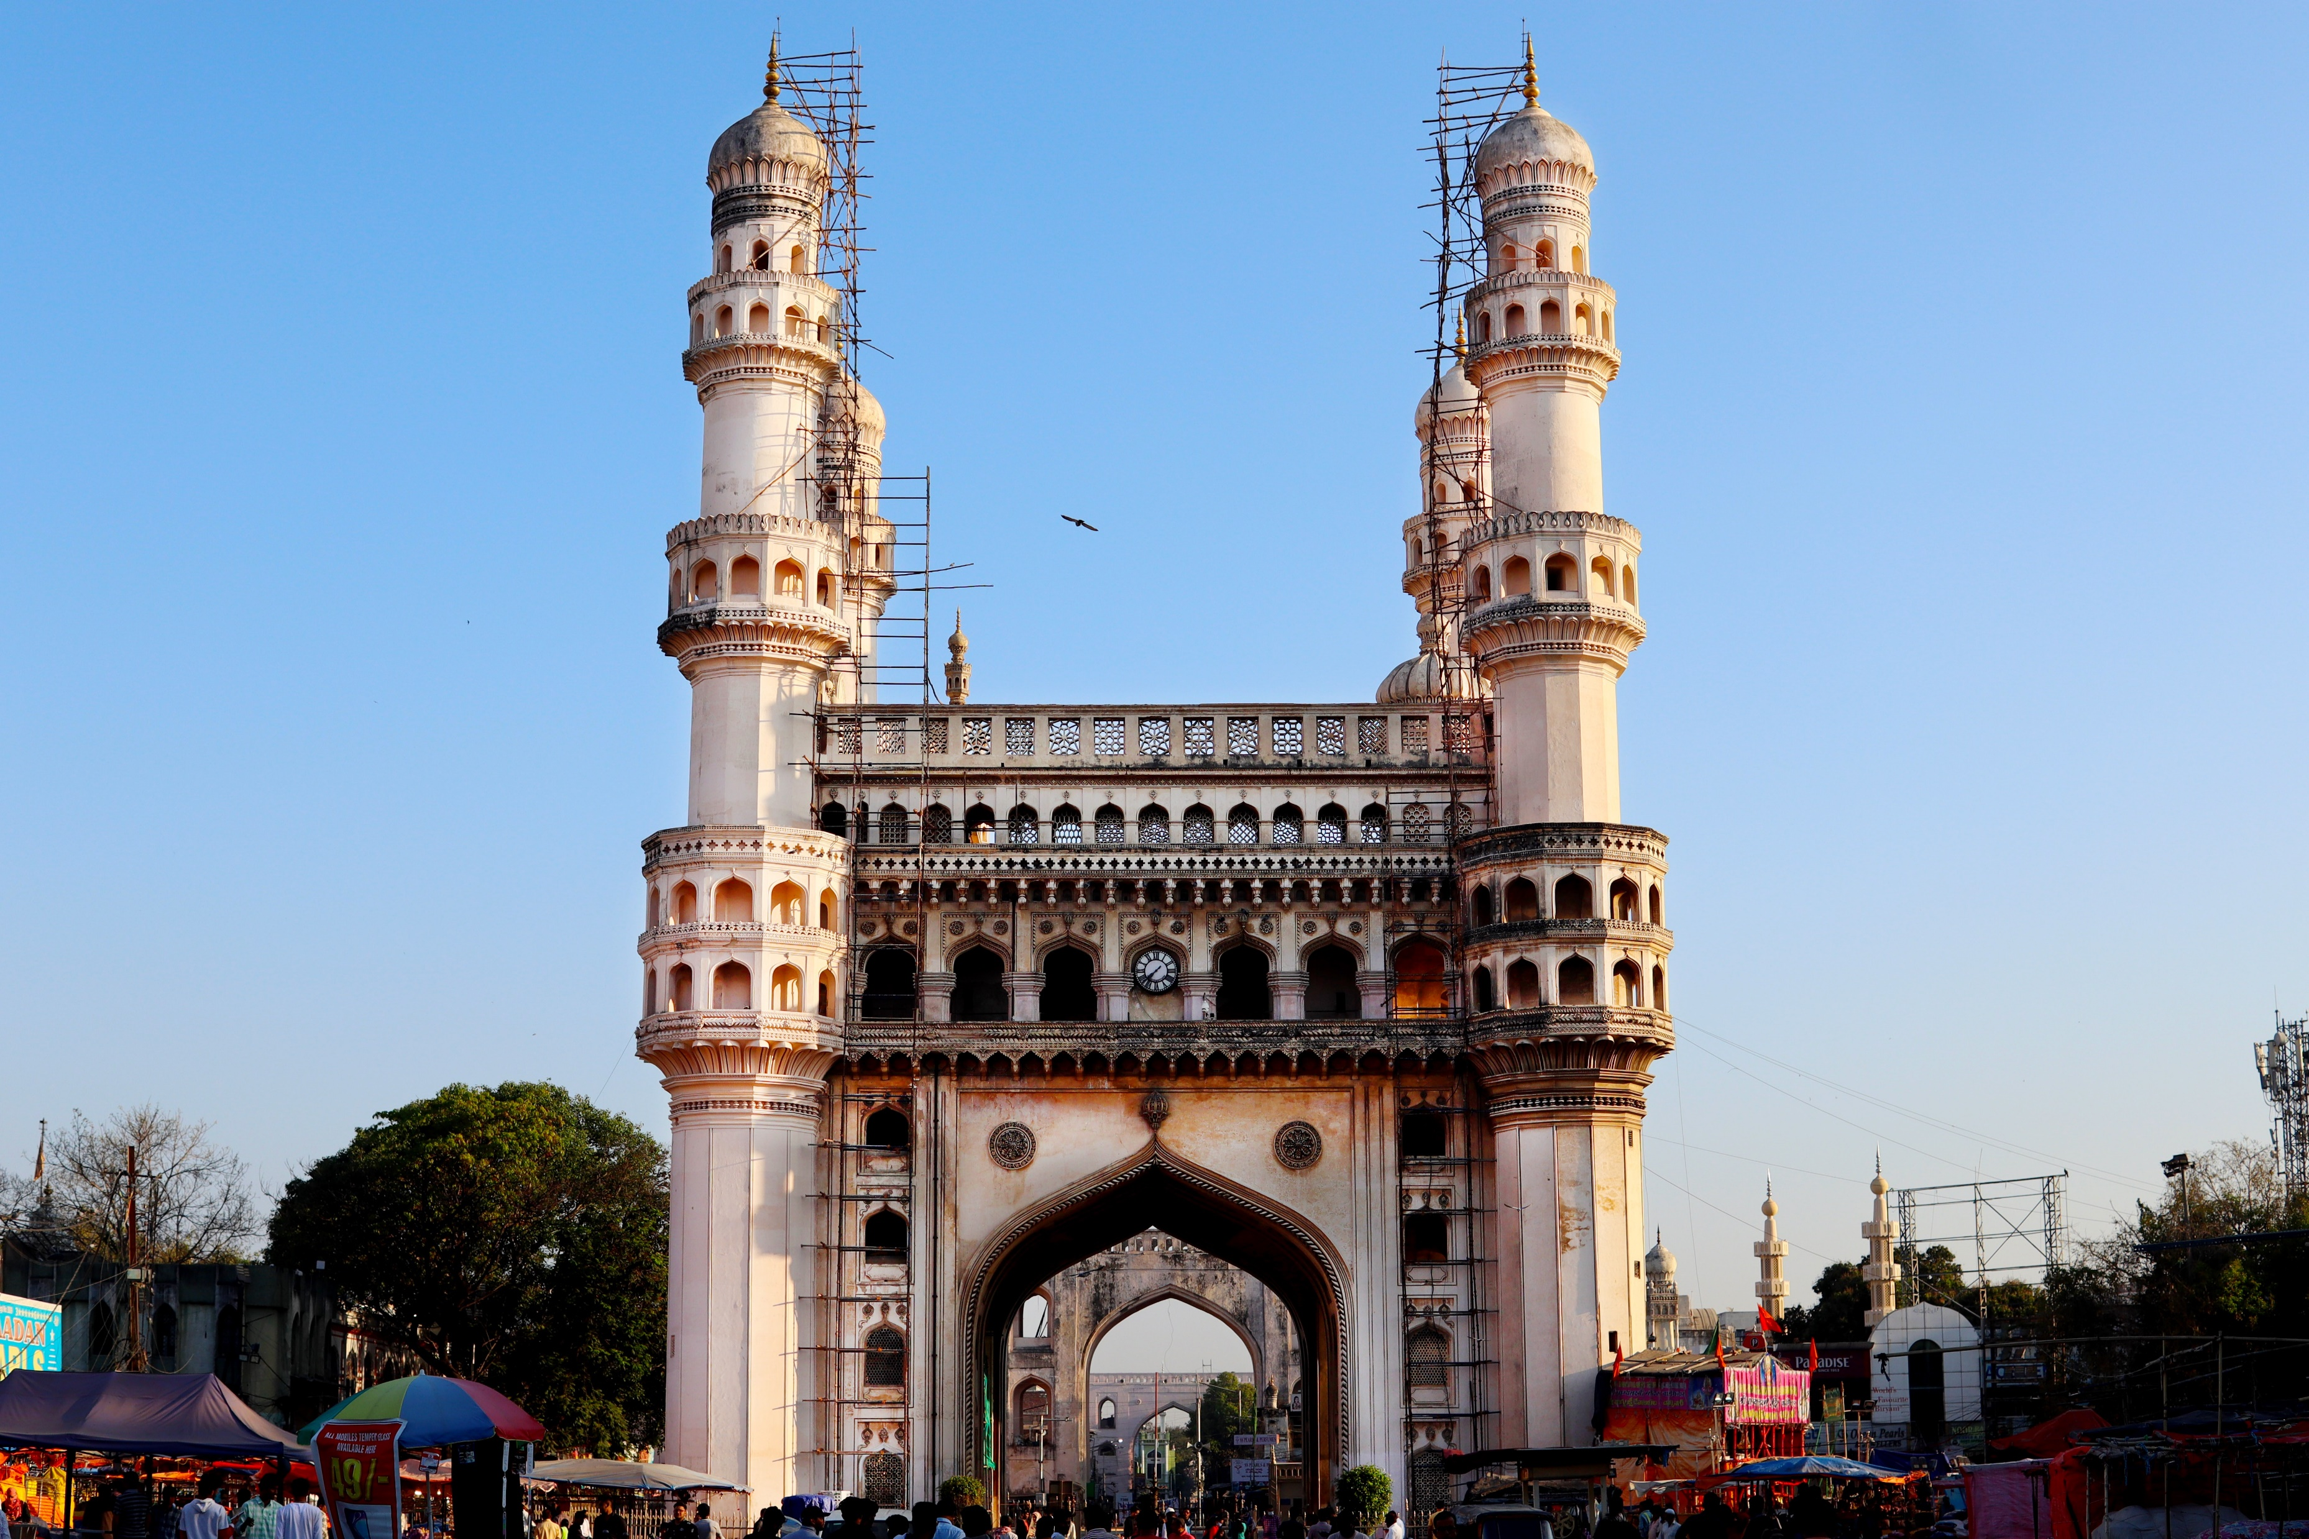
﻿
CAGR based insights
How to boost Hyderabad tourism industry
Hyderabad is a capital of Telangana. Tourism in Hyderabad can be boosted by taking several measures, including the following: Offering Unique Experiences: Hyderabad can offer unique experiences such as food walks, heritage walks, cultural performances, and adventure tourism activities to attract tourists.
Encouraging Community Participation: Encouraging local communities to participate in tourism activities and promoting their traditional crafts and culture can create a sense of ownership and pride and promote sustainable tourism.
Improving Safety and Security: Ensuring the safety and security of tourists by providing a safe and secure environment can increase the trust of tourists and encourage them to visit again.

Slide 14
Thank You!
A challenge by

